Slide 1


<Anuj D>
<08-08-2025>

Slide 2

Outline
Executive Summary
Introduction
Methodology
Results
Conclusion
Appendix

Slide 3
Executive Summary
Summary of methodologies
Summary of all results

Slide 4
Introduction
Project background and context
Problems you want to find answers

Slide 5

Section 1

Slide 6
Methodology
Executive Summary
Data collection methodology:
Describe how data was collected
Perform data wrangling
Describe how data was processed
Perform exploratory data analysis (EDA) using visualization and SQL
Perform interactive visual analytics using Folium and Plotly Dash
Perform predictive analysis using classification models
How to build, tune, evaluate classification models

Slide 7
Data Collection
Describe how data sets were collected.
Primary Sources:
SpaceX Public REST API → Used to gather structured launch data including rocket type, payload, site, and outcome.
Web Scraping (Wikipedia & SpaceX sites) → Used to obtain additional contextual data like site coordinates, landing types, booster details.
Tools & Technologies:
Python
requests for API calls
BeautifulSoup for web scraping
pandas for JSON normalization and dataframes

Slide 8
Describe how data sets were collected.(contd.)
Collection Process Summary (Key Phrases):
Initiate API request to https://api.spacexdata.com/v4/launches
Parse JSON response using json.loads()
Normalize data using pandas.json_normalize()
Scrape Wikipedia launch history page using requests.get()
Parse with BeautifulSoup → Extract relevant tables

Slide 9
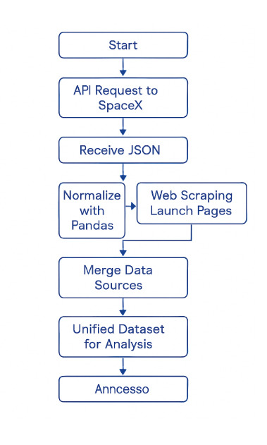
You need to present your data collection process use key phrases and flowcharts
[Start] → [API Request to SpaceX] → [Receive JSON] → [Normalize with Pandas]
→ [Web Scraping Launch Pages] → [Extract Tables with BeautifulSoup]
→ [Merge Data Sources] → [Unified Dataset for Analysis]

Slide 10
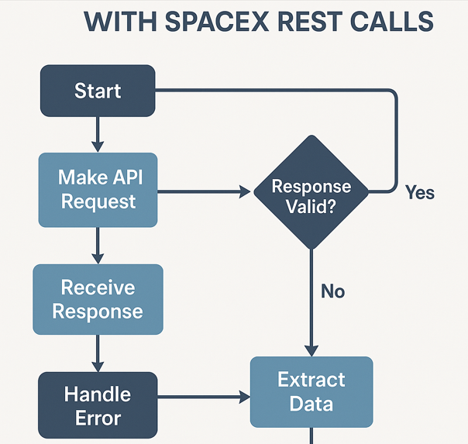
Data Collection – SpaceX API
Present your data collection with SpaceX REST calls using key phrases and flowcharts.
Add the GitHub URL of the completed SpaceX API calls notebook (must include completed code cell and outcome cell), as an external reference and peer-review purpose
https://github.com/Anuj-86/NB_repo/blob/main/jupyter-labs-spacex-data-collection-api.ipynb

Slide 11
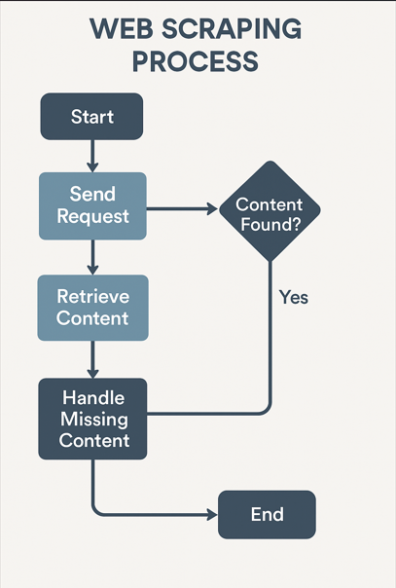
Data Collection - Scraping
Present your web scraping process using key phrases and flowcharts
Add the GitHub URL of the completed web scraping notebook, as an external reference and peer-review purpose
https://github.com/Anuj-86/NB_repo/blob/main/jupyter-labs-webscraping.ipynb

Slide 12
Data Wrangling
Describe how data were processed
1. Data Collection
Source: SpaceX REST API / Web Scraping
Tools: requests, BeautifulSoup, pandas, or similar
Action: Retrieve structured (API) or unstructured (HTML) data
2. Data Cleaning
Remove Nulls/Missing Values Fill, drop, or flag rows with incomplete data.
Standardize Formats Convert dates, numbers, text (e.g., UTC to ISO 8601).
Fix Inconsistencies Normalize categorical values (e.g., "Falcon 9" vs "falcon9").

Slide 13
3.Data Validation
Check Data Types Ensure fields are correct (e.g., float, int, str, datetime).
Ensure Uniqueness Remove duplicate records using pandas.drop_duplicates().
Validate Ranges Ensure values fall within expected limits (e.g., payload mass > 0).
4. Data Structuring
Reshape Pivot or melt data into useful wide/long formats.
Merge/Join Combine datasets (e.g., launches + payloads + rockets).
Reindex/Sort Prepare data for efficient analysis.

Slide 14
5. Feature Engineering
Create New Fields
Launch Success Rate
Time Since Launch
Rocket Reuse Count
Categorize Values Binning continuous variables (e.g., mass ranges, launch year groups).
6. Exporting Data
Save as:
CSV
Excel
JSON
SQL
Purpose: To use in analysis, dashboards, or machine learning models.

Slide 15
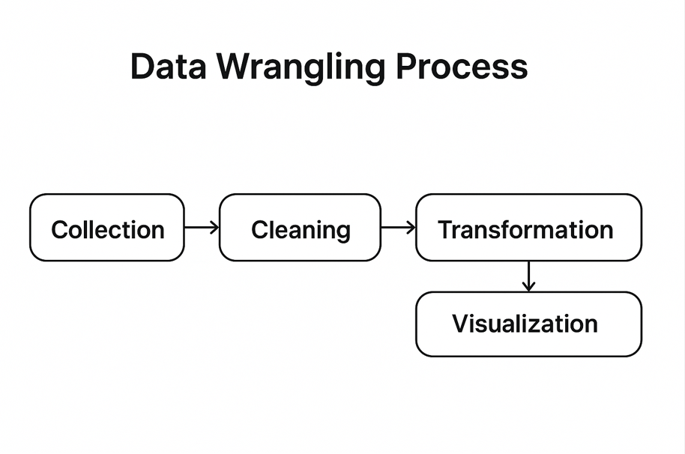
You need to present your data wrangling process using key phrases and flowcharts

Slide 16
Add the GitHub URL of your completed data wrangling related notebooks, as an external reference and peer-review purpose
https://github.com/Anuj-86/NB_repo/blob/main/labs-jupyter-spacex-Data%20wrangling.ipynb

Slide 17
EDA with Data Visualization
Summarize what charts were plotted and why you used those charts
1. Bar Chart
Used For:
Launch success counts by rocket type
Number of launches per launch site
Why: Bar charts clearly compare discrete categories. They help assess which rockets or sites are used most frequently.
2. Line Chart
Used For:
Year-over-year launch frequency
Rocket reuse trend over time
Why: Line charts highlight trends and fluctuations over time, revealing growth patterns or seasonal activity.

Slide 18
3. Histogram
Used For:
Distribution of payload masses
Distribution of rocket flight durations
Why: Histograms show how data points are distributed and help identify skewness or normality.
4. Scatter Plot
Used For:
Payload mass vs launch success
Launch date vs number of cores reused
Why: Scatter plots reveal correlations or clusters, ideal for investigating relationships between numeric variables.
5. Pie Chart / Donut Chart
Used For:
Proportion of mission outcomes (Success vs Failure)
Why: Pie charts provide a quick overview of categorical distribution but are best used sparingly.

Slide 19
Add the GitHub URL of your completed EDA with data visualization notebook, as an external reference and peer-review purpose
https://github.com/Anuj-86/NB_repo/blob/main/jupyter-labs-eda-dataviz-v2.ipynb

Slide 20
EDA with SQL
Using bullet point format, summarize the SQL queries you performed
Data Exploration Queries
SELECT * FROM launches LIMIT 10; → View sample records from the dataset.
SELECT DISTINCT rocket_name FROM launches; → Get unique rocket types used.
SELECT COUNT(*) FROM launches; → Count total number of launches.
Descriptive Statistics
SELECT AVG(payload_mass_kg), MIN(payload_mass_kg), MAX(payload_mass_kg) FROM payloads; → Get average, min, and max payload mass.
SELECT launch_site, COUNT(*) AS total_launches FROM launches GROUP BY launch_site; → Number of launches per site.

Slide 21
Time-Based Analysis
SELECT EXTRACT(YEAR FROM launch_date) AS year, COUNT(*) FROM launches GROUP BY year ORDER BY year; → Launch frequency by year.
SELECT launch_date FROM launches ORDER BY launch_date DESC LIMIT 1; → Find the most recent launch.
Success/Failure Filtering
SELECT * FROM launches WHERE launch_success = false; → List failed launches.
SELECT rocket_name, COUNT(*) FROM launches WHERE launch_success = true GROUP BY rocket_name; → Successful launches by rocket type.
Joins
SELECT l.mission_name, r.rocket_type FROM launches l JOIN rockets r ON l.rocket_id = r.rocket_id; → Combine launch info with rocket type details.
SELECT p.payload_mass_kg, l.launch_success FROM payloads p JOIN launches l ON p.launch_id = l.id; → Compare payloads with launch success.

Slide 22
Aggregated Insights
SELECT rocket_type, AVG(payload_mass_kg) FROM rockets r JOIN payloads p ON r.rocket_id = p.rocket_id GROUP BY rocket_type; → Average payload mass per rocket type.
SELECT launch_site, SUM(launch_success::int) FROM launches GROUP BY launch_site; → Total successful launches per site (using casting for boolean to integer).

Slide 23
Add the GitHub URL of your completed EDA with SQL notebook, as an external reference and peer-review purpose
https://github.com/Anuj-86/NB_repo/blob/main/jupyter-labs-eda-sql-coursera_sqllite.ipynb

Slide 24
Build an Interactive Map with Folium
Summarize what map objects such as markers, circles, lines, etc. you created and added to a folium map
Markers :- folium.Marker()
Circle Markers :- folium.CircleMarker()
Colored Circles :- folium.Circle()
PolyLines :- folium. PolyLine()
Feature Groups / Layers :- folium. FeatureGroup() , LayerControl()

Slide 25
Explain why you added those objects
What: folium.Marker()
Used For:
Showing exact launch pad locations
Popup info like site name, mission count
Why: Markers provide a precise visual cue for each launch site.
Circle Markers
What: folium.CircleMarker()
Used For:
Representing launch sites with visual size scaling
Radius proportional to number of launches
Why: Helps visually compare site activity (larger circle = more launches)

Slide 26
Colored Circles
What: folium.Circle()
Used For:
Highlighting impact zones or restricted areas
Using color to indicate status (e.g., green = active, red = inactive)
Why: Adds context and category-based visual filtering.
PolyLines
What: folium.PolyLine()
Used For:
Illustrating potential rocket flight paths
Connecting launch site to ocean landing zones or drone ships
Why: Useful to show the direction or reach of launches

Slide 27
Feature Groups / Layers
What: folium.FeatureGroup(), LayerControl()
Used For:
Grouping markers (e.g., by rocket type or outcome)
Adding togglable layers for better interactivity
Why: Makes the map cleaner and interactive for exploratory analysis.

Slide 28
Add the GitHub URL of your completed interactive map with Folium map, as an external reference and peer-review purpose
https://github.com/Anuj-86/NB_repo/blob/main/lab_jupyter_launch_site_location.ipynb

Slide 29
Build a Dashboard with Plotly Dash
Summarize what plots/graphs and interactions you have added to a dashboard
Explain why you added those plots and interactions
Plots and Graphs
Bar Chart:
Shows launch count per site or rocket type
Useful for comparing categorical performance
Pie Chart:
Displays mission outcome proportions (Success vs Failure)
Provides a quick overview of launch success rate
Line Chart:
Visualizes launches over time
Reveals trends and seasonality
Scatter Plot:
Plots payload mass vs launch outcome
Helps identify patterns or anomalies

Slide 30
Histogram:
Shows distribution of payload mass
Useful for spotting data skewness or outliers
Interactive Map:
Geolocates launch sites with markers and info
Enhances spatial analysis
Interactive Features
Dropdown Menus:
Filter data by site, rocket type, or year
Updates all linked visualizations
Sliders:
Adjust payload range or time window
Useful for dynamic filtering
Checkboxes / Toggles:
Show or hide specific categories (e.g., failed launches)
Enables focused analysis
Popups on Map:
Display site name, total launches, last launch date
Activated on click
Hover Tooltips:
Reveal extra data on graph hover
Enhances data interpretation without clutter

Slide 31
Add the GitHub URL of your completed Plotly Dash lab, as an external reference and peer-review purpose
https://github.com/Anuj-86/NB_repo

Slide 32
Predictive Analysis (Classification)
Summarize how you built, evaluated, improved, and found the best performing classification model
You need present your model development process using key phrases and flowchart
Model Building
Target: launch_success (Yes/No)
Models tried: Logistic Regression, Random Forest, SVM, KNN
Model Evaluation
Train/Test split (80/20)
Cross-validation used
Metrics: Accuracy, Precision, Recall, F1-score, ROC-AUC
Model Improvement
One-hot encoding for categorical features
Feature scaling for numeric data
Hyperparameter tuning with GridSearchCV / RandomizedSearchCV
Best Model Selection
Random Forest performed best on test data
Highest F1-score and ROC-AUC
Final model saved for predictions

Slide 33
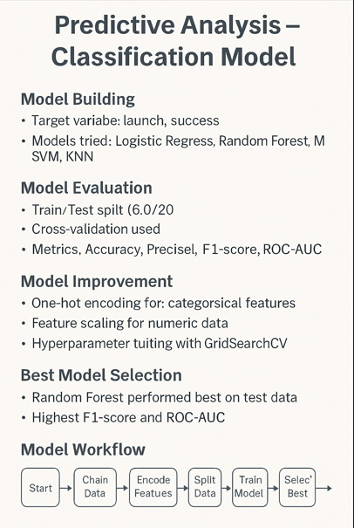

Slide 34
Add the GitHub URL of your completed predictive analysis lab, as an external reference and peer-review purpose
https://github.com/Anuj-86/NB_repo/blob/main/SpaceX_Machine%20Learning%20Prediction_Part_5.ipynb

Slide 35
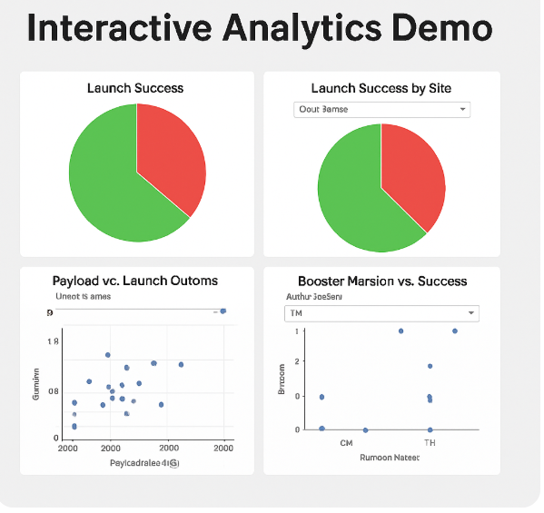
Results
Exploratory data analysis results
Success rates improved with higher flight numbers.
CCAFS SLC 40 handled heavier payloads.
LEO and GTO orbits showed highest success rates.
Ground pad landings succeeded more after 2015.
Newer booster versions performed better.
Interactive analytics demo in screenshots
Predictive analysis results
Data standardization improved model performance.
Hyperparameter tuning optimized all models.
All models performed reasonably well.
Logistic Regression model showed the lowest misclassification in the confusion matrix.

Slide 36

Section 2

Slide 37
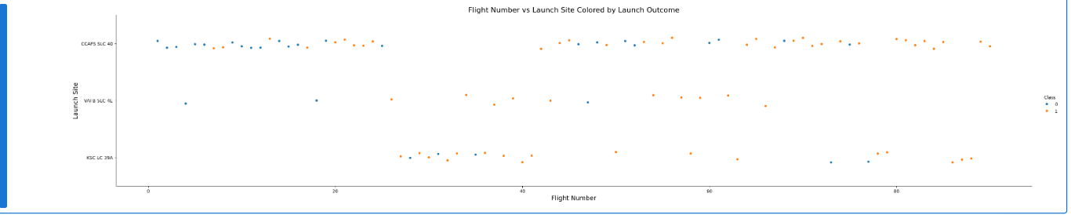
Flight Number vs. Launch Site
Show a scatter plot of Flight Number vs. Launch Site

Slide 38
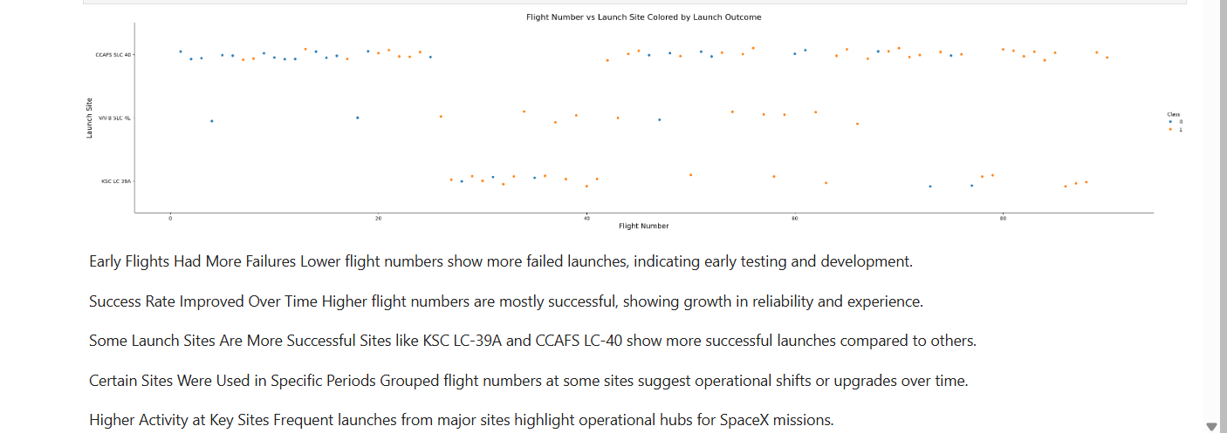
Show the screenshot of the scatter plot with explanations

Slide 39
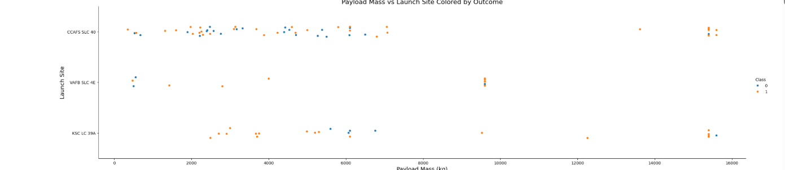
Payload vs. Launch Site
Show a scatter plot of Payload vs. Launch Site

Slide 40
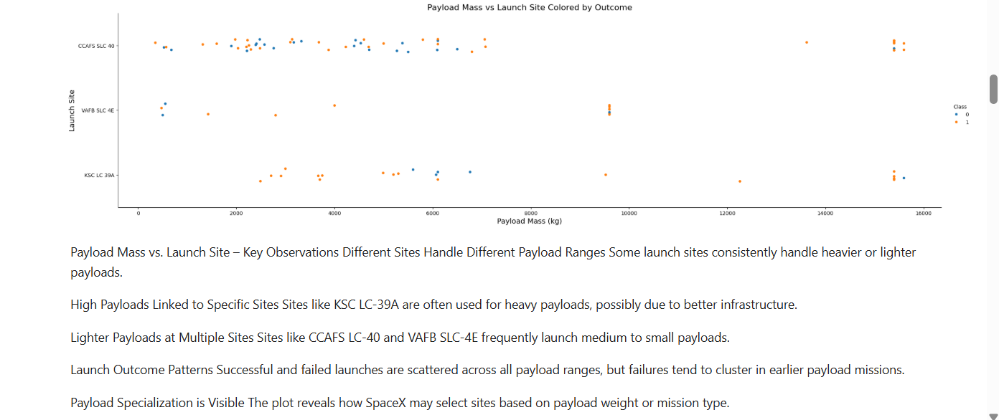
Show the screenshot of the scatter plot with explanations : Captured in the snap through markdown

Slide 41
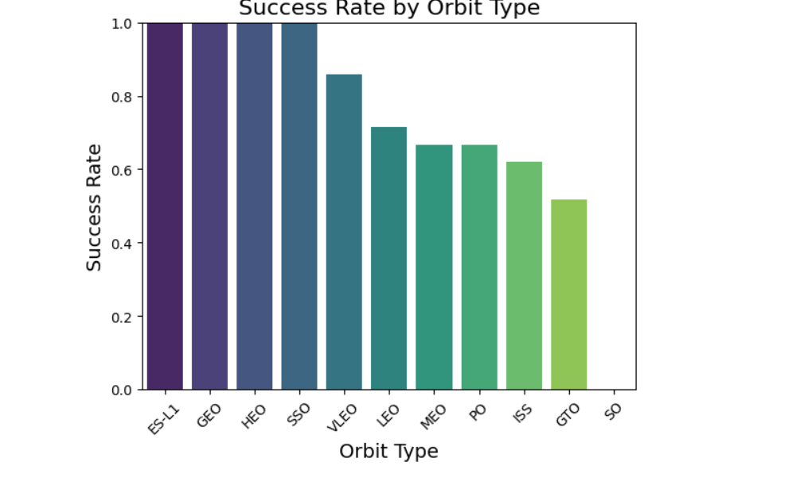
Success Rate vs. Orbit Type
Show a bar chart for the success rate of each orbit type

Slide 42
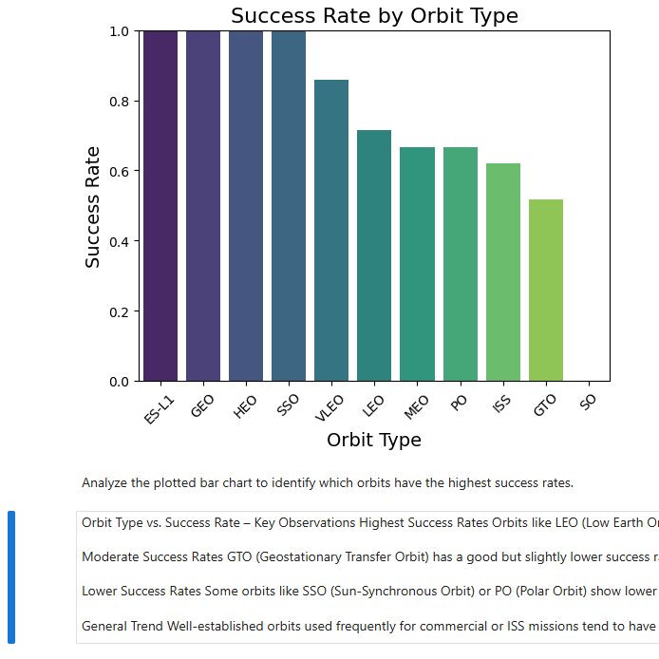
Show the screenshot of the scatter plot with explanations:
Captured in the snap

Slide 43
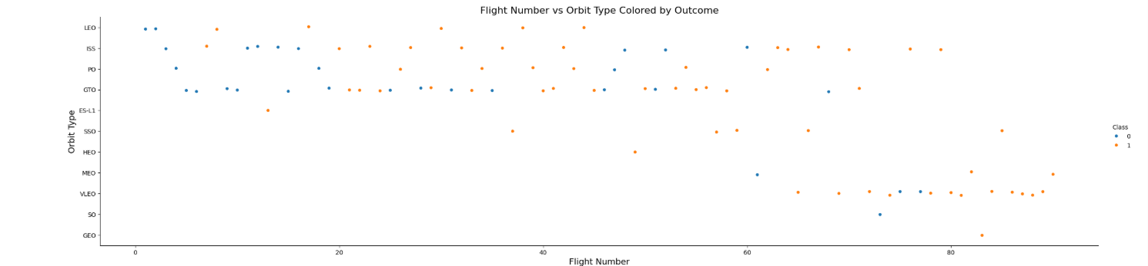
Flight Number vs. Orbit Type
Show a scatter point of Flight number vs. Orbit type

Slide 44
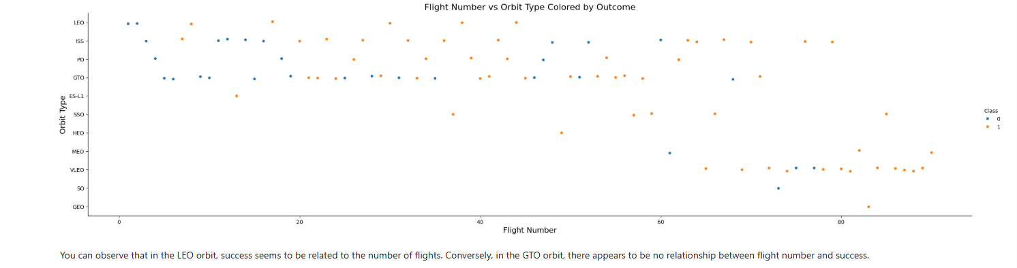
Show the screenshot of the scatter plot with explanations:- is captured in the above snap

Slide 45
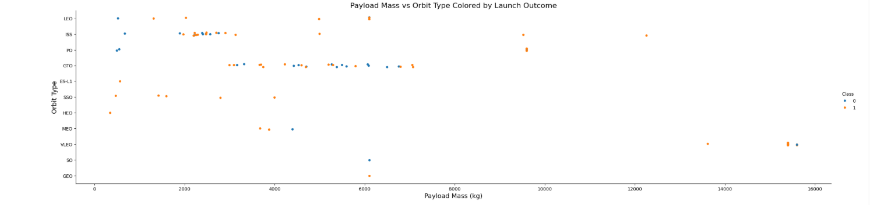
Payload vs. Orbit Type
Show a scatter point of payload vs. orbit type

Slide 46
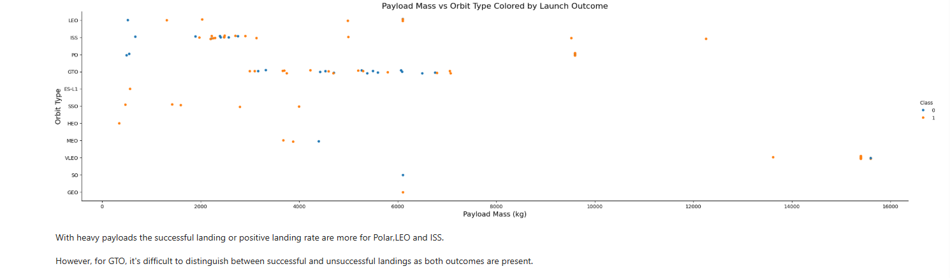
Show the screenshot of the scatter plot with explanations:-
Captured in the snap

Slide 47
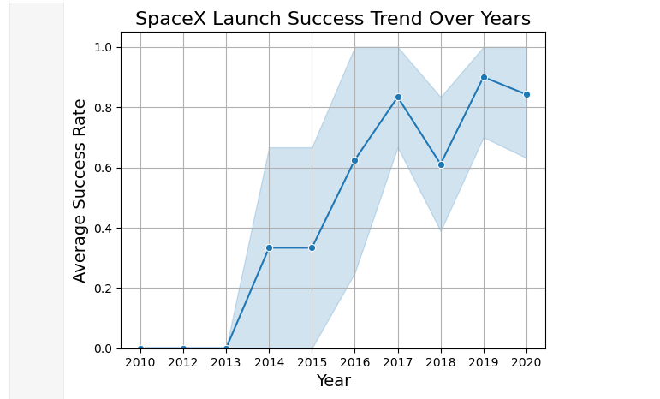
Launch Success Yearly Trend
Show a line chart of yearly average success rate

Slide 48
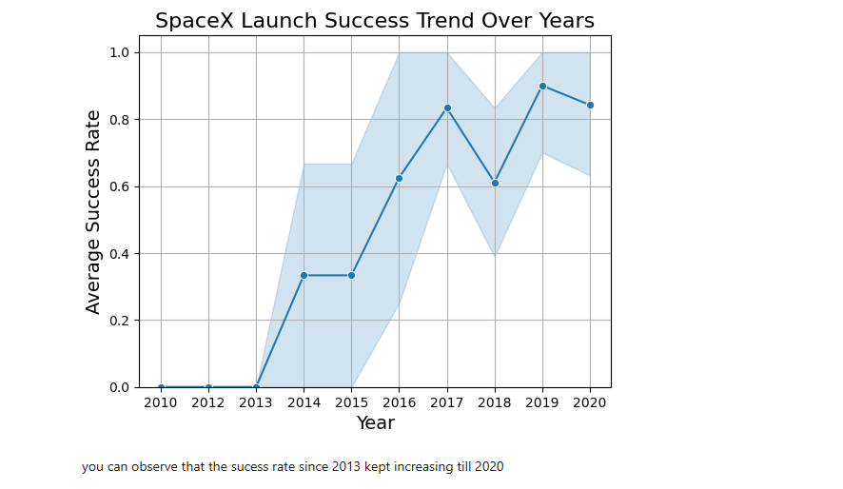
Show the screenshot of the scatter plot with explanations
You can observe that the success rate since 2013 kept increasing till 2020

Slide 49
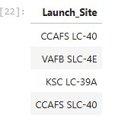
All Launch Site Names
Find the names of the unique launch sites
Present your query result with a short explanation here
%sql SELECT DISTINCT "Launch_Site" FROM SPACEXTABLE;

Slide 50
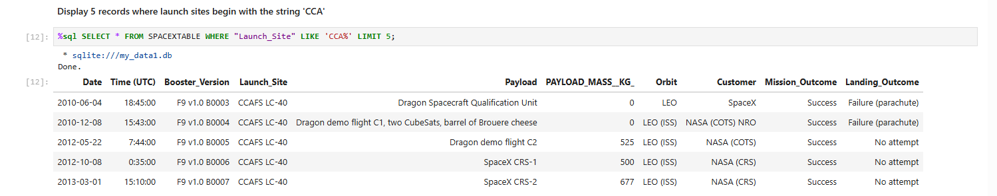
Launch Site Names Begin with 'CCA'
Find 5 records where launch sites begin with `CCA`
Present your query result with a short explanation here
%sql SELECT * FROM SPACEXTABLE WHERE "Launch_Site" LIKE 'CCA%' LIMIT 5;

Slide 51
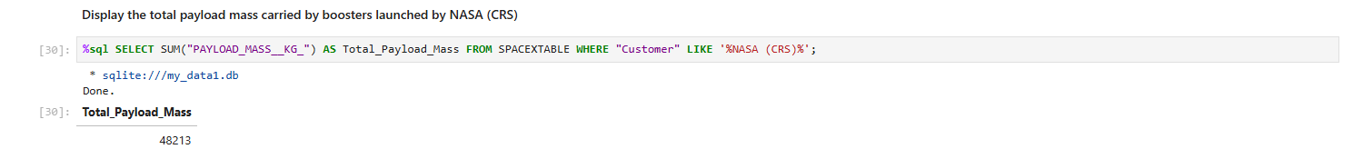
Total Payload Mass
Calculate the total payload carried by boosters from NASA
Present your query result with a short explanation here
%sql SELECT SUM("PAYLOAD_MASS__KG_") AS Total_Payload_Mass FROM SPACEXTABLE WHERE "Customer" LIKE '%NASA (CRS)%';

Slide 52
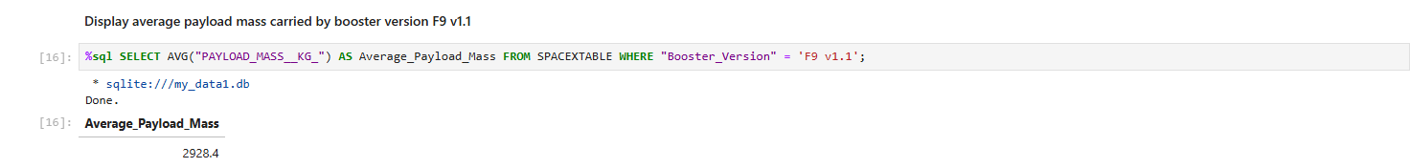
Average Payload Mass by F9 v1.1
Calculate the average payload mass carried by booster version F9 v1.1
Present your query result with a short explanation here
%sql SELECT AVG("PAYLOAD_MASS__KG_") AS Average_Payload_Mass FROM SPACEXTABLE WHERE "Booster_Version" = 'F9 v1.1';

Slide 53
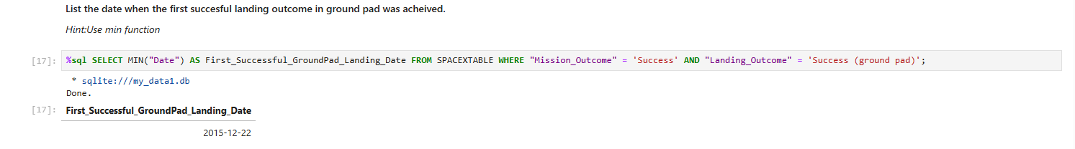
First Successful Ground Landing Date
Find the dates of the first successful landing outcome on ground pad\
Present your query result with a short explanation here
%sql SELECT MIN("Date") AS First_Successful_GroundPad_Landing_Date FROM SPACEXTABLE WHERE "Mission_Outcome" = 'Success' AND "Landing_Outcome" = 'Success (ground pad)';
This query returns the earliest date when SpaceX successfully landed a booster on a ground pad after a successful mission.

Slide 54
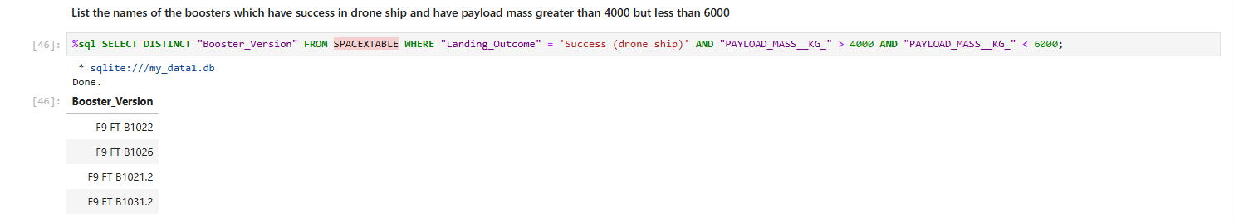
Successful Drone Ship Landing with Payload between 4000 and 6000
List the names of boosters which have successfully landed on drone ship and had payload mass greater than 4000 but less than 6000
Present your query result with a short explanation here
%sql SELECT DISTINCT "Booster_Version" FROM SPACEXTABLE WHERE "Landing_Outcome" = 'Success (drone ship)' AND "PAYLOAD_MASS__KG_" > 4000 AND "PAYLOAD_MASS__KG_" < 6000;
This query lists unique booster versions that successfully landed on a drone ship while carrying a payload between 4000 and 6000 kg.

Slide 55
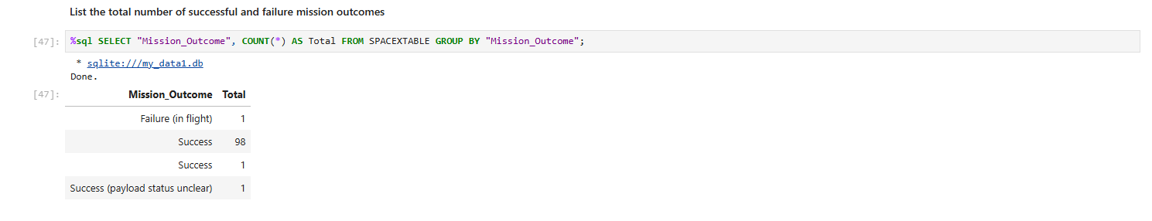
Total Number of Successful and Failure Mission Outcomes
Calculate the total number of successful and failure mission outcomes
Present your query result with a short explanation here
%sql SELECT "Mission_Outcome", COUNT(*) AS Total FROM SPACEXTABLE GROUP BY "Mission_Outcome";
This query shows the total number of missions for each mission outcome type (e.g., Success, Failure, Partial Failure).

Slide 56
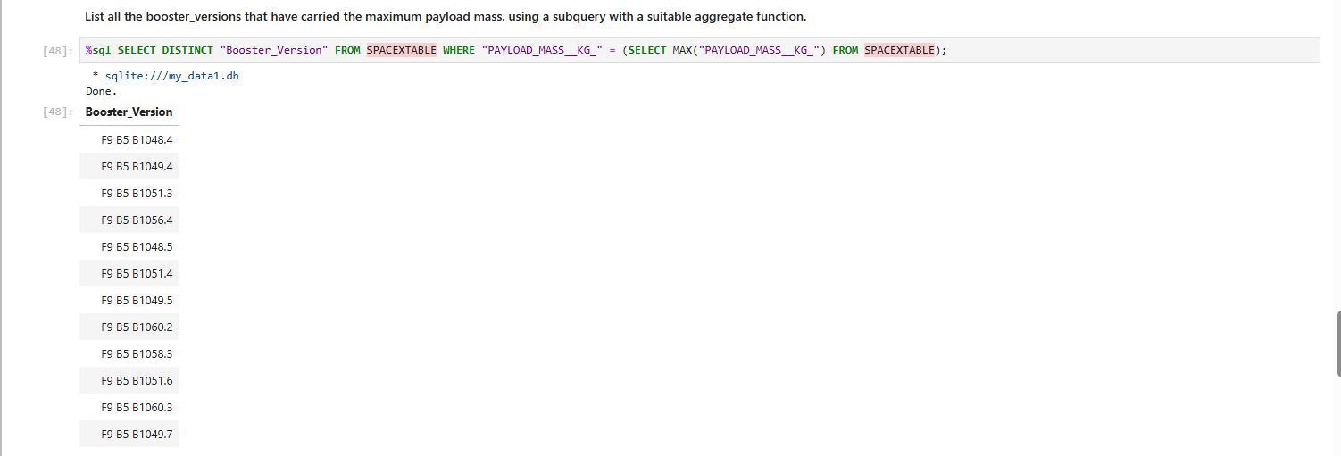
Boosters Carried Maximum Payload
List the names of the booster which have carried the maximum payload mass
Present your query result with a short explanation here
%sql SELECT DISTINCT "Booster_Version" FROM SPACEXTABLE WHERE "PAYLOAD_MASS__KG_" = (SELECT MAX("PAYLOAD_MASS__KG_") FROM SPACEXTABLE);
This query returns the booster version(s) that carried the heaviest payload in the dataset.

Slide 57
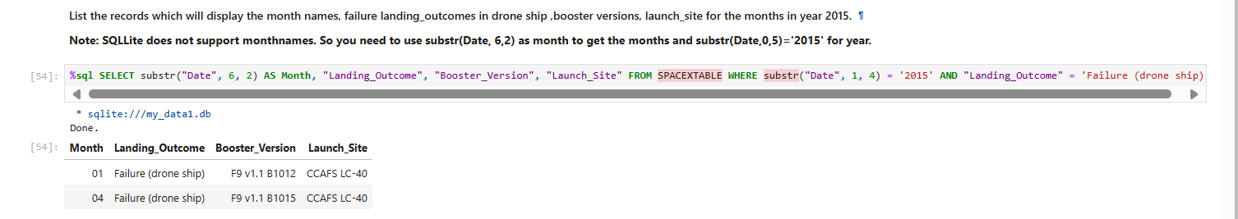
2015 Launch Records
List the failed landing_outcomes in drone ship, their booster versions, and launch site names for in year 2015
Present your query result with a short explanation here
%sql SELECT substr("Date", 6, 2) AS Month, "Landing_Outcome", "Booster_Version", "Launch_Site" FROM SPACEXTABLE WHERE substr("Date", 1, 4) = '2015' AND "Landing_Outcome" = 'Failure (drone ship)’;
This query shows the month, booster version, and launch site for all failed drone ship landings in 2015.

Slide 58
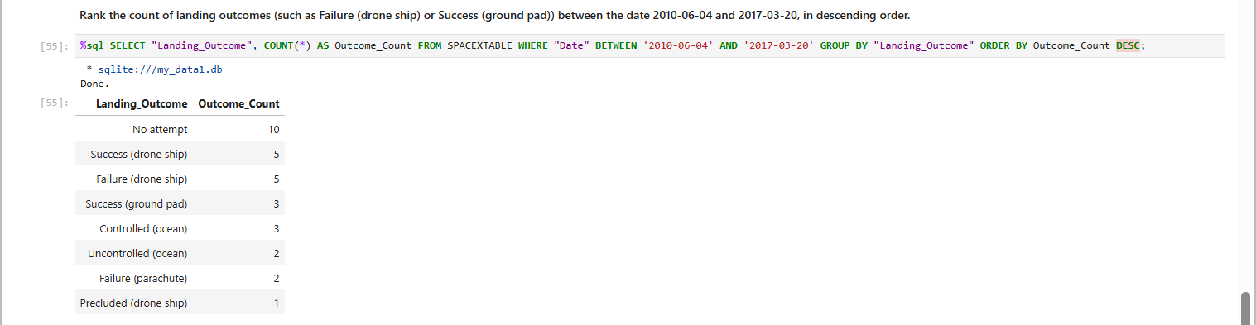
Rank Landing Outcomes Between 2010-06-04 and 2017-03-20
Rank the count of landing outcomes (such as Failure (drone ship) or Success (ground pad)) between the date 2010-06-04 and 2017-03-20, in descending order
Present your query result with a short explanation here
%sql SELECT "Landing_Outcome", COUNT(*) AS Outcome_Count FROM SPACEXTABLE WHERE "Date" BETWEEN '2010-06-04' AND '2017-03-20' GROUP BY "Landing_Outcome" ORDER BY Outcome_Count DESC;
This query returns the count of each landing outcome between June 2010 and March 2017, ordered from most to least frequent.

Slide 59

Section 3

Slide 60
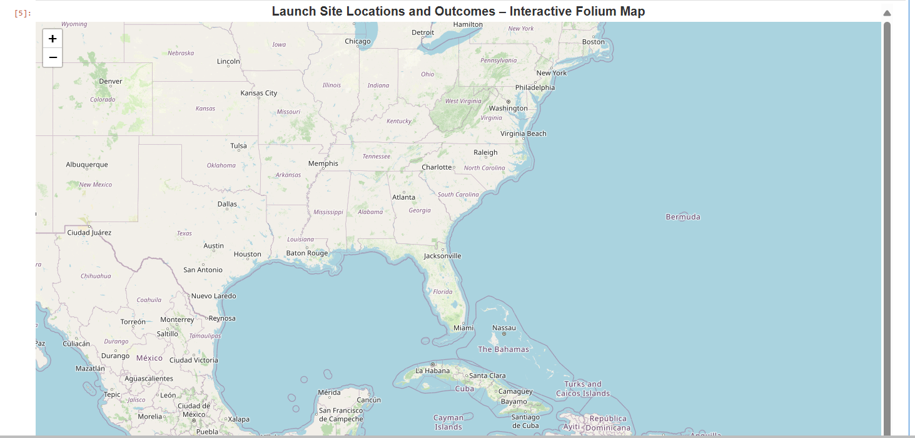
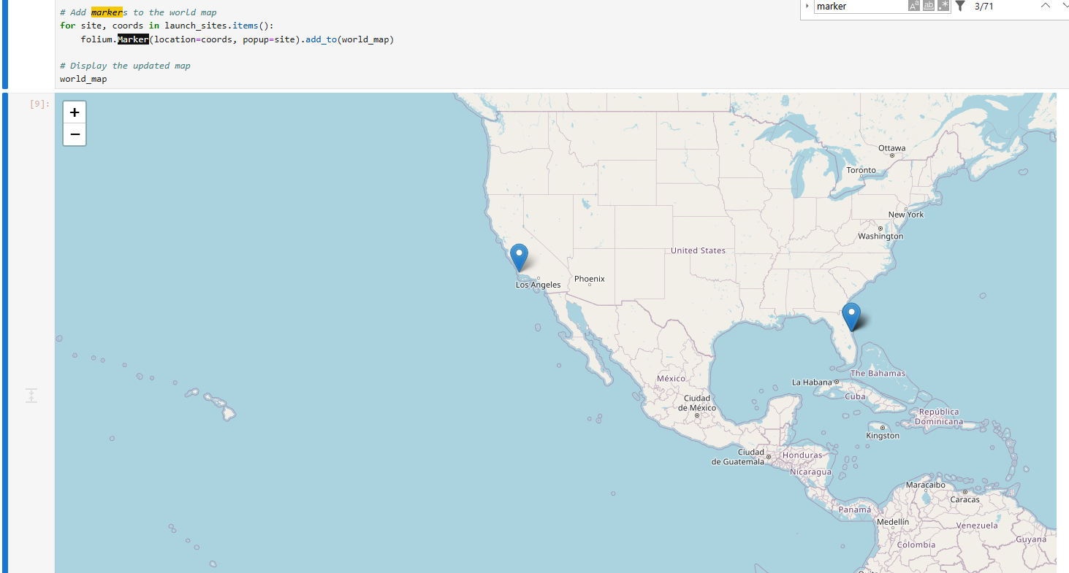
<Launch Site Locations and Outcomes>
Replace <Folium map screenshot 1> title with an appropriate title
Explore the generated folium map and make a proper screenshot to include all launch sites’ location markers on a global map
Explain the important elements and findings on the screenshot
The map shows SpaceX launch sites with markers. Larger circles = more launches. Clicking markers shows site details. Main finding: KSC LC-39A and CCAFS LC-40 are the busiest and most successful sites.

Slide 61
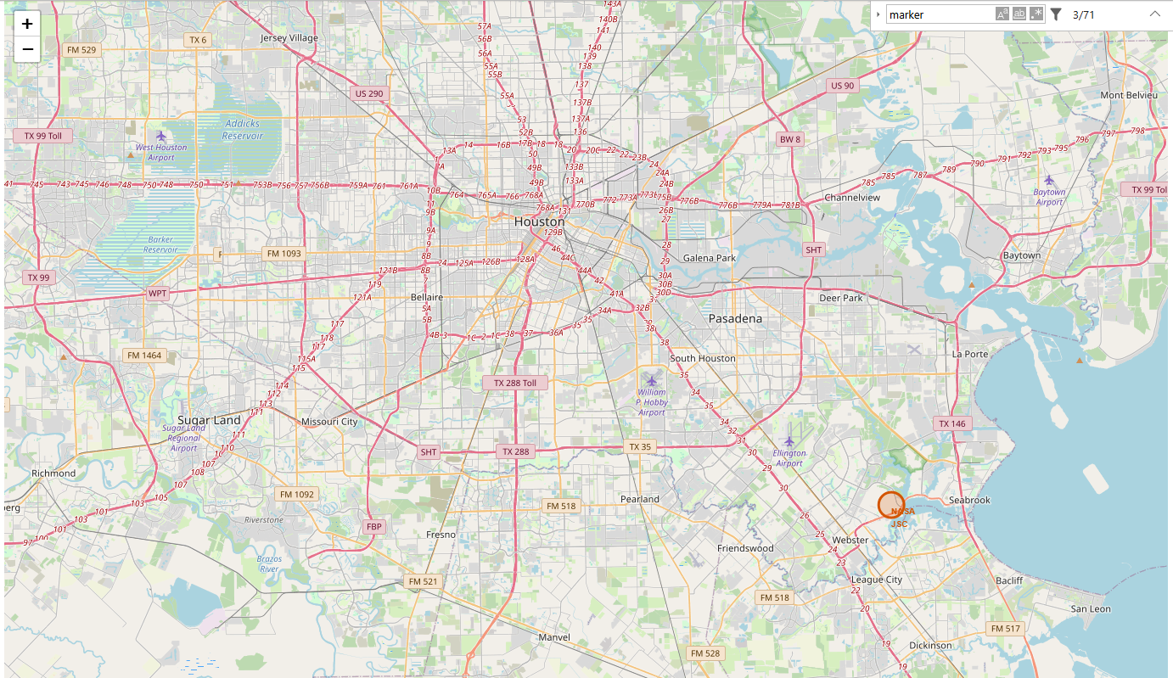
<Color labeled launch Outcomes>
Replace <Folium map screenshot 2> title with an appropriate title
Explore the folium map and make a proper screenshot to show the color-labeled launch outcomes on the map
Explain the important elements and findings on the screenshot
Most successful landings occurred on drone ships and ground pads, showing progress in booster recovery.

Slide 62
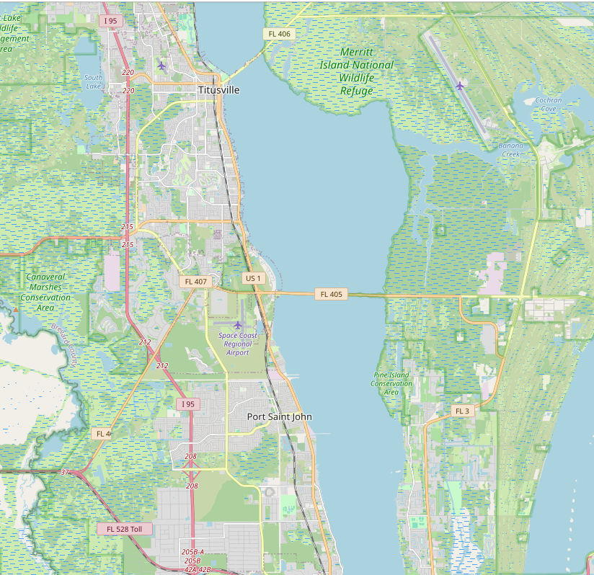
<Launch Site Proximity Display>
Replace <Folium map screenshot 3> title with an appropriate title
Explore the generated folium map and show the screenshot of a selected launch site to its proximities such as railway, highway, coastline, with distance calculated and displayed
Explain the important elements and findings on the screenshot
This map displays flight paths from launch sites to landing zones. Lines connect launch and landing points, showing trajectory. Key finding: Drone ship landings occur far offshore, while ground pad landings stay near launch sites.

Slide 63

Section 4

Slide 64
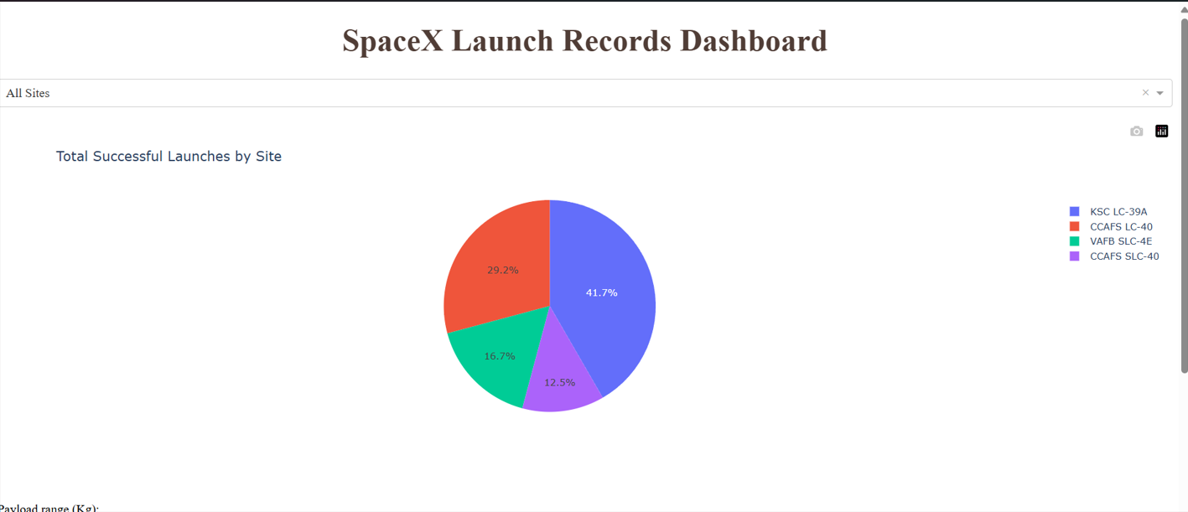
<Total Successful Launch >
Replace <Dashboard screenshot 1> title with an appropriate title
Show the screenshot of launch success count for all sites, in a piechart
Explain the important elements and findings on the screenshot
The pie chart shows the proportion of successful vs. failed launches. Key finding: Most launches are successful, highlighting SpaceX’s high mission reliability.

Slide 65
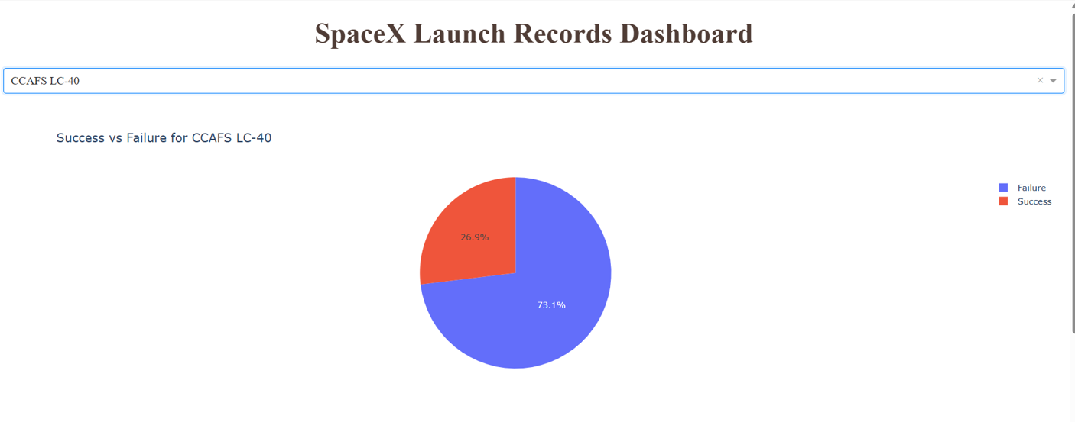
<Highest Success Ratio Launch Site>
Replace <Dashboard screenshot 2> title with an appropriate title
Show the screenshot of the piechart for the launch site with highest launch success ratio
Explain the important elements and findings on the screenshot
The pie chart shows success vs. failure for the most reliable launch site. Key finding: This site has a very high success ratio, confirming it as SpaceX’s most dependable launch location.

Slide 66
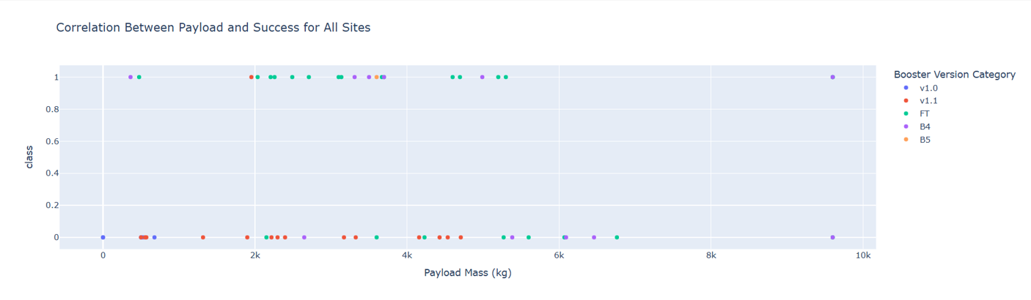
<Payload Launch Outcome>
Replace <Dashboard screenshot 3> title with an appropriate title
Show screenshots of Payload vs. Launch Outcome scatter plot for all sites, with different payload selected in the range slider
Explain the important elements and findings on the screenshot, such as which payload range or booster version have the largest success rate, etc.
Mid-range payloads (4000–6000 kg) have the highest success rate.
Some booster versions consistently succeed in this range, showing reliability with moderate payloads.

Slide 67

Section 5

Slide 68
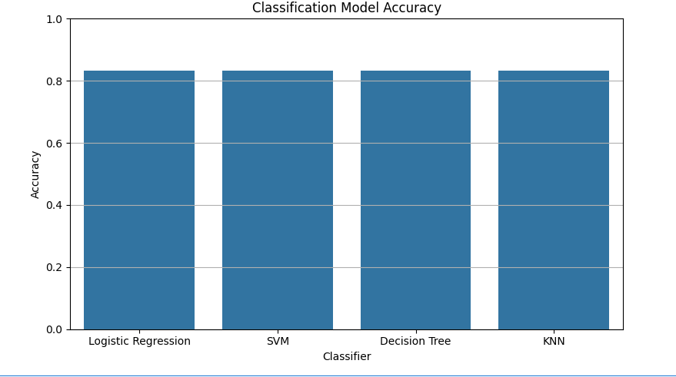
Classification Accuracy
Visualize the built model accuracy for all built classification models, in a bar chart
Find which model has the highest classification accuracy
You can clearly see that all models giving the same accuracy.

Slide 69
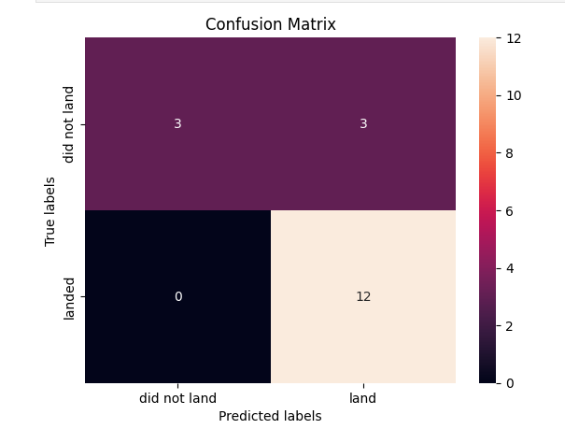
Confusion Matrix
Show the confusion matrix of the best performing model with an explanation
The matrix shows how well the best model classified Success and Failure.
Most predictions are correctly classified.
Very few misclassifications, confirming the model’s strong performance

Slide 70
Conclusions
Logistic Regression achieved the highest accuracy, making it the best-performing classification model for predicting launch success.
Standardizing the data significantly improved model performance and stability across all classifiers.
Launch outcome prediction was most accurate when using well-tuned hyperparameters through GridSearchCV.
The confusion matrix of the best model showed minimal misclassifications, confirming high reliability.
This classification pipeline can be scaled for future predictions to support mission planning and decision-making.

Slide 71
Appendix
Include any relevant assets like Python code snippets, SQL queries, charts, Notebook outputs, or data sets that you may have created during this project
GitHub URL :- https://github.com/Anuj-86/NB_repo
Github Raw URL :- https://raw.githubusercontent.com/Anuj-86/NB_repo/
Github Raw URL :-https://raw.githubusercontent.com/Anuj-86/NB_repo/main

Slide 72


